Slide 1
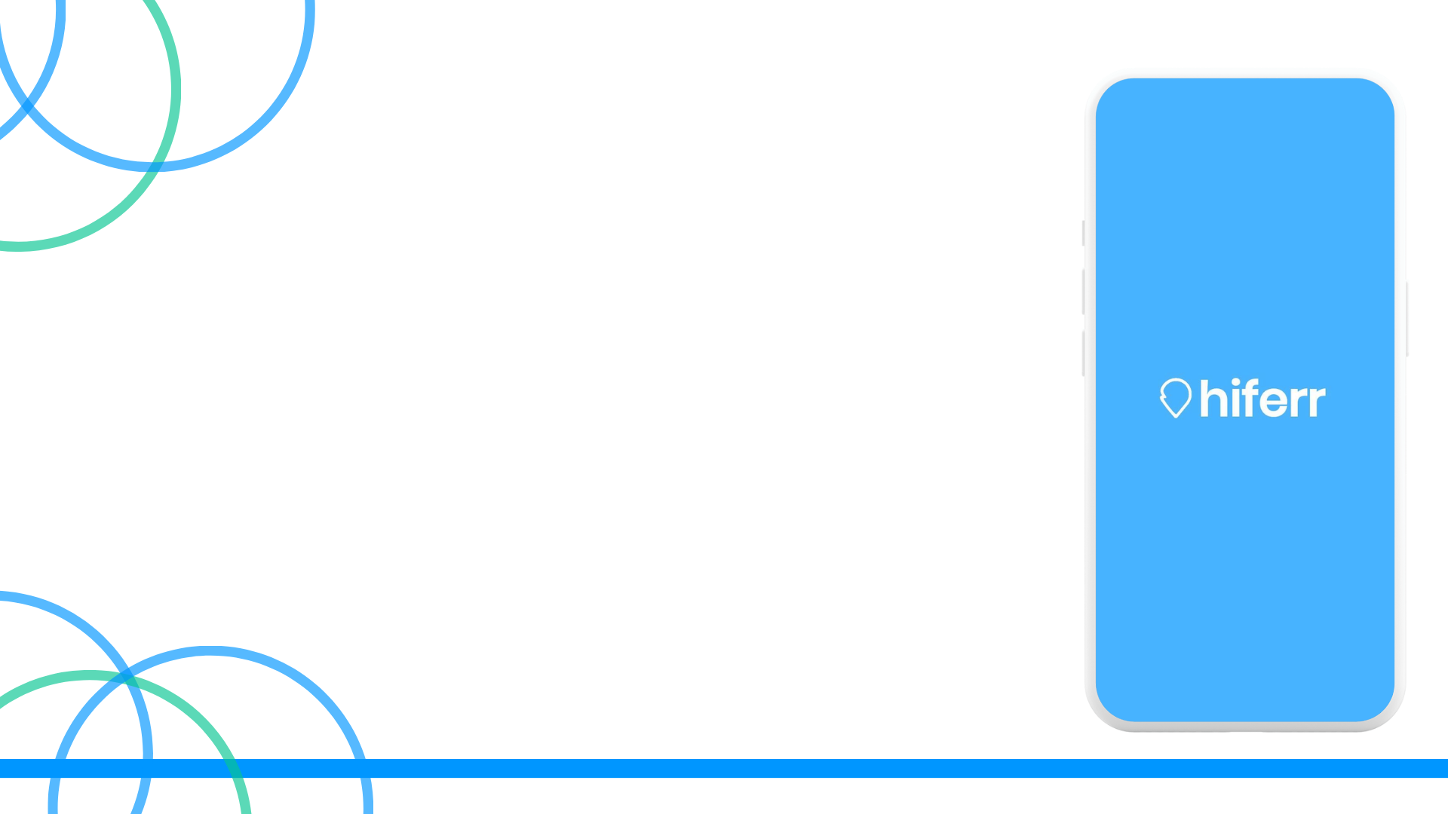
Hiferr
App Audit by Studio Mosaic

Slide 2
Contents
1. In App Bugs
2. App UI/UX Analysis
Onboarding Screens
In app screens
App tutorial
3. Additional Recommendations
Monetization-Related Recommendations
Feature-Related Recommendations
Push Notification Strategy
Review pop-up

Slide 3
In App Bugs
Devices used: Samsung A50 & Iphone XR

Slide 4
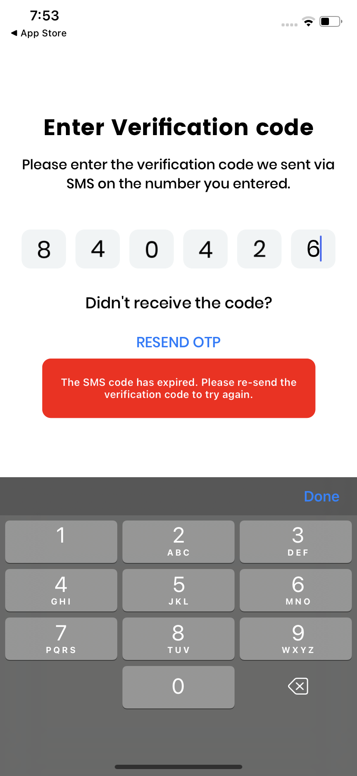
In App Bugs
The user does not receive verification SMS at once. The verification SMS had to be re-sent to proceed further, after which the code expired and was required to be re-sent - this kind of friction in the user experience can result in high drop off.

Slide 5
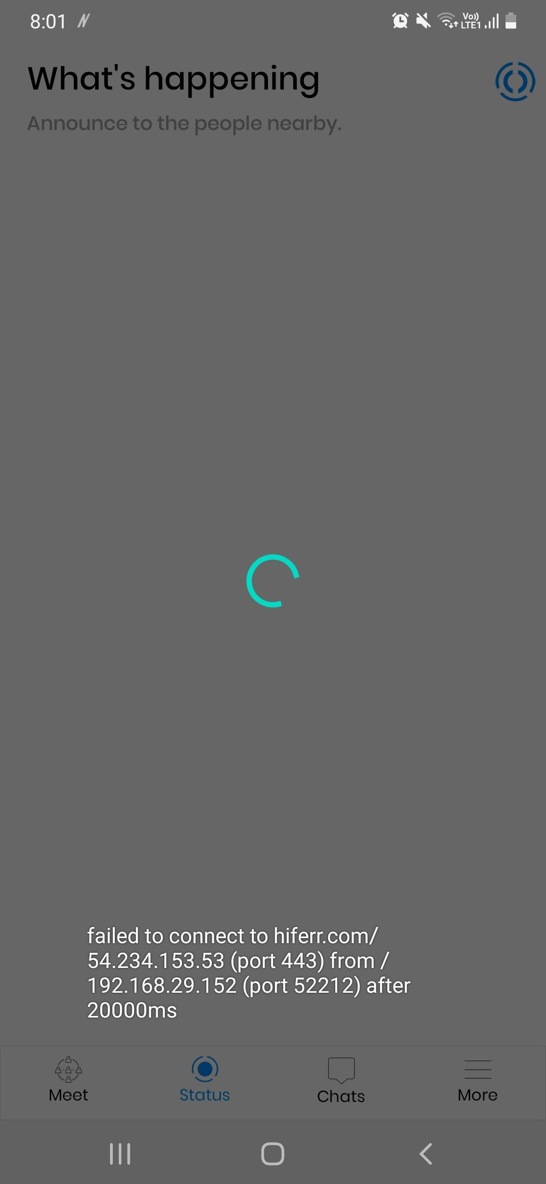
In App Bugs
We faced frequent crashes between 18th March to 21st March - please find the screenshot attached on the right.

Slide 6
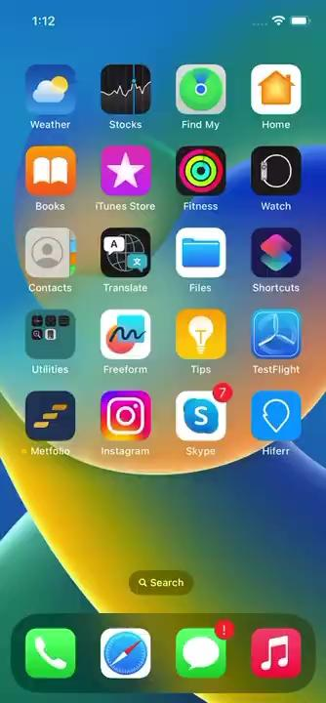
In App Bugs
Some devices are experiencing frequent crashes when attempting to access the app, this can result in high deletion rate. Please find the video attached on the right.

Slide 7
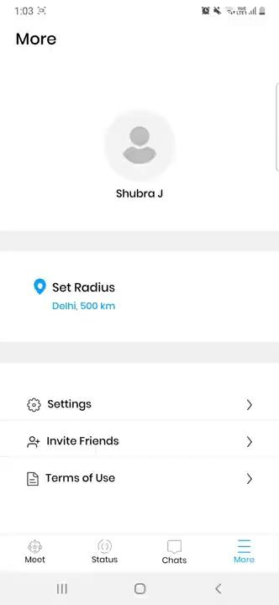
In App Bugs
Upon selecting "Invite Friends" from the "More" menu, the user is prompted to share the invite message with their contacts through SMS. However, even after granting permission to share the message with the contacts, no contacts are displayed on the screen - please find the video attached on the right.

Slide 8
App UI/UX Analysis

Slide 9
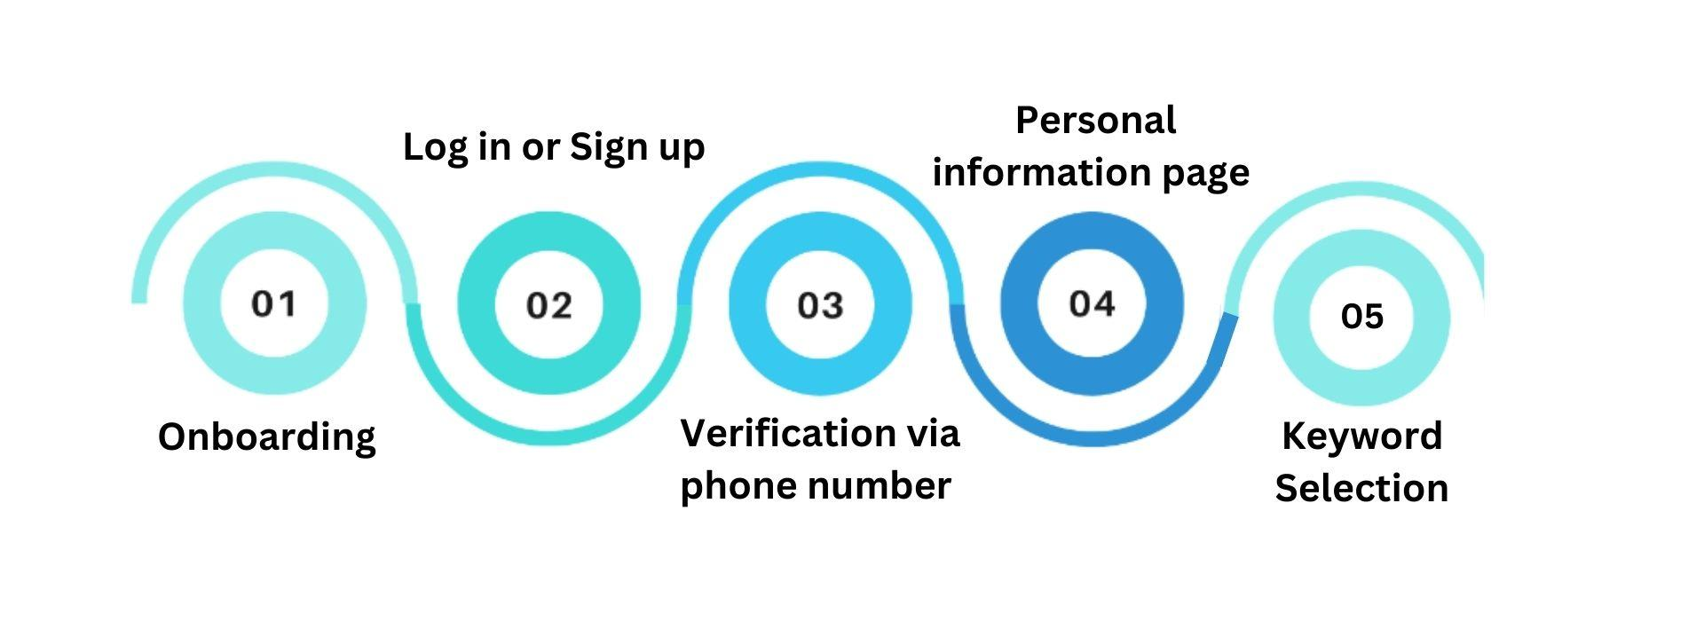
Current App User Flow

Slide 10
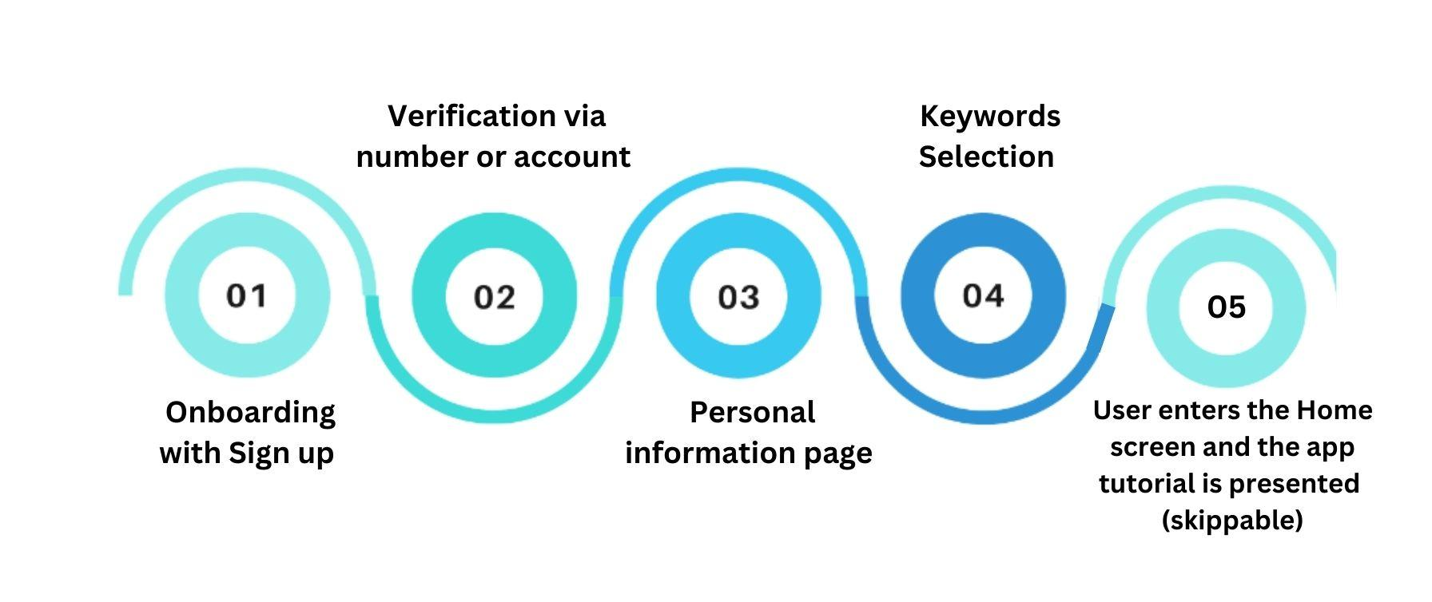
Recommended App User Flow

Slide 11
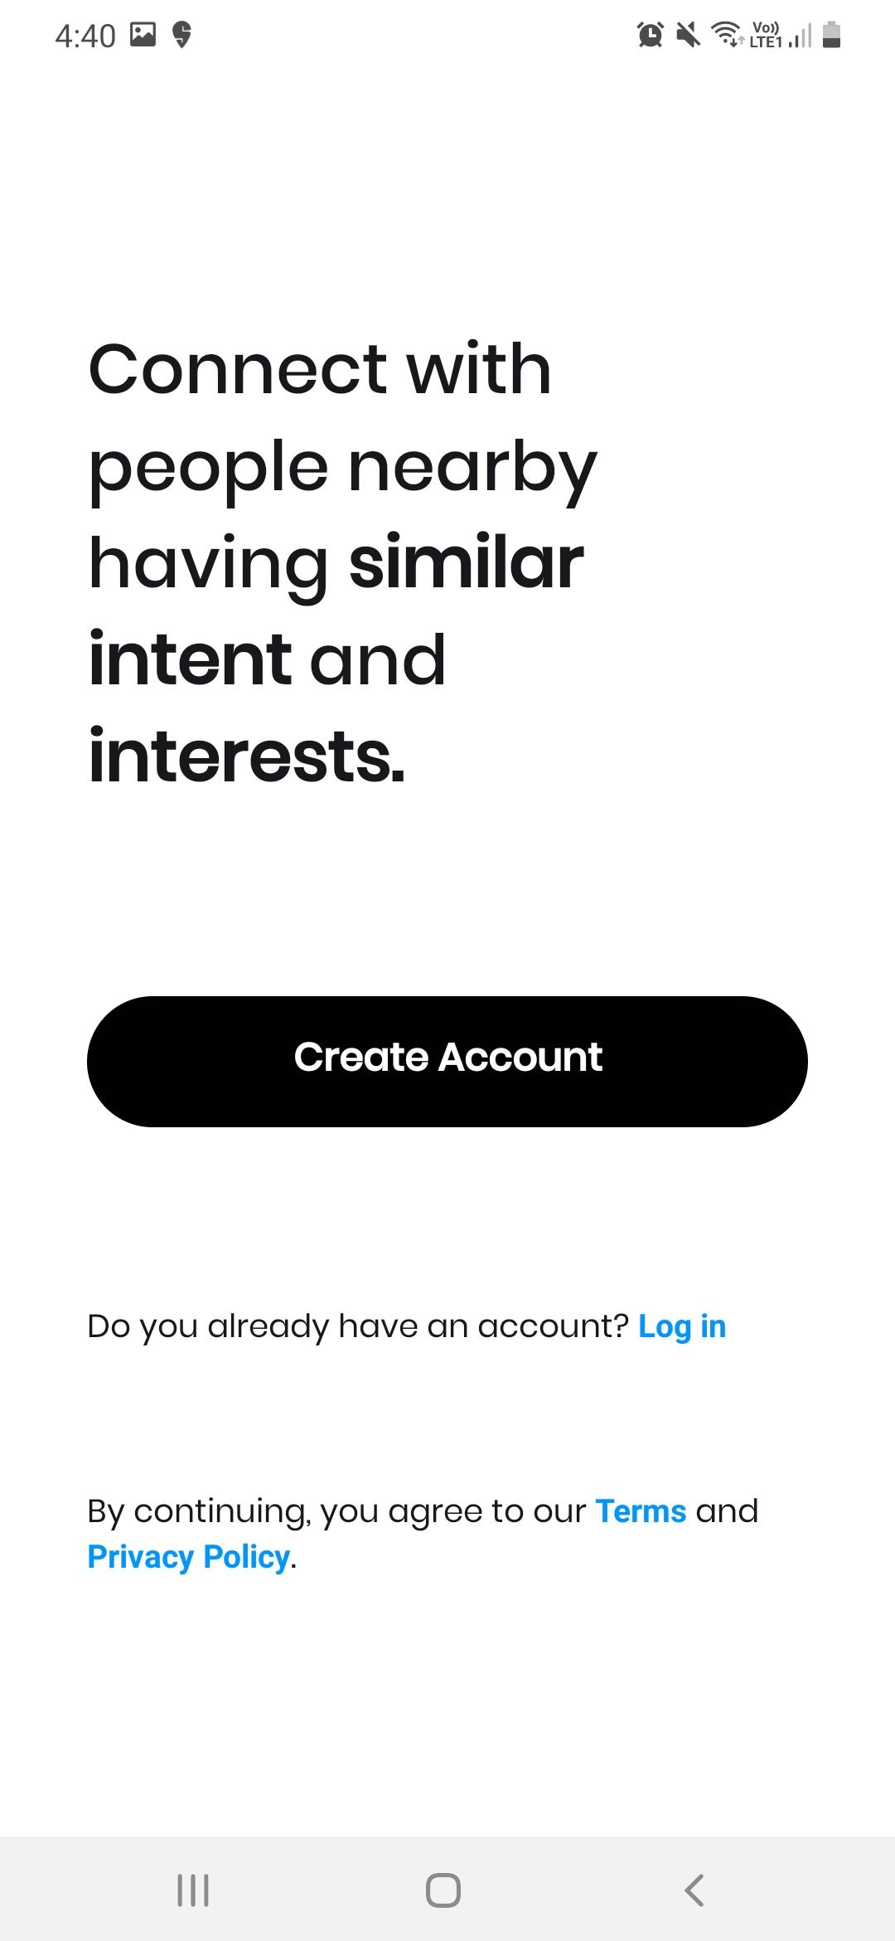
User Onboarding
While the overall look of the screens is minimal and clean, the current onboarding screens does not engage or educate the user about the features of the app and its USPs.
The application's current sign-up options are limited, as it doesn't offer sign-up options through Google, Apple, or Facebook.
The option of creating an account solely through phone number can be restricting and many users might get discouraged to sign up due to security concerns.

Slide 12
Onboarding screens - Recommendations
An engaging onboarding screen can both, prompt a new user to create an account and also showcases the key features of the app increasing the sign up rate.
We recommend adding swipeable onboarding screens for users to showcase the app USPs.
The wireframe of the sign up screen for android and iOS are attached here.
Please find recommended Sign up screen text here.

Slide 13
Sign Up - Recommendations
An OTP can be sent when a user provides a phone number or email. In case of sign up via facebook/google/apple, the screen can be redirected to get the automatic verification. Please refer here for an example. This will limit users from creating multiple accounts through the same id.
Users should be provided with a prompt while creating an account, informing them that their personal details would not being shared with any third party. This would be helpful in gaining user trust. Please find an example here.

Slide 14
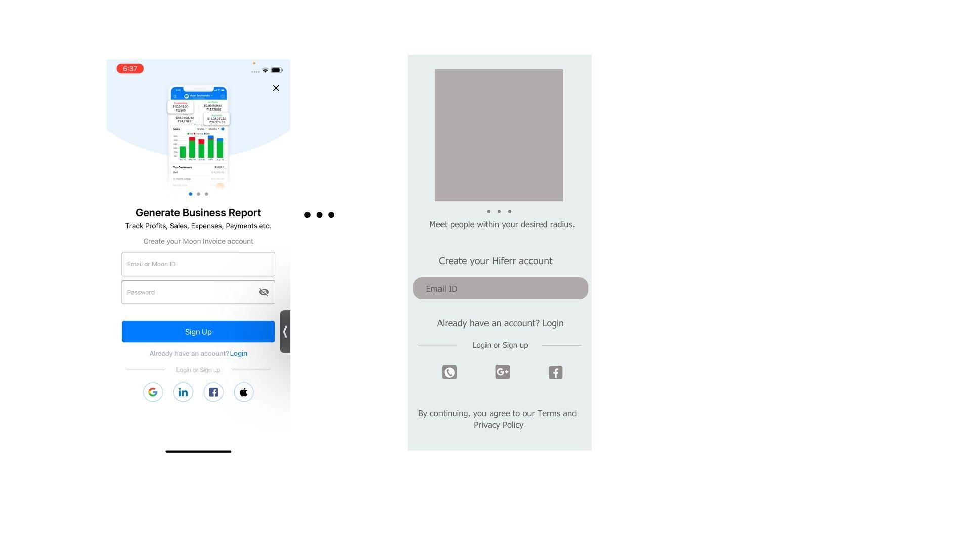

Onboarding screens Wireframes
Android
iOS

Slide 15
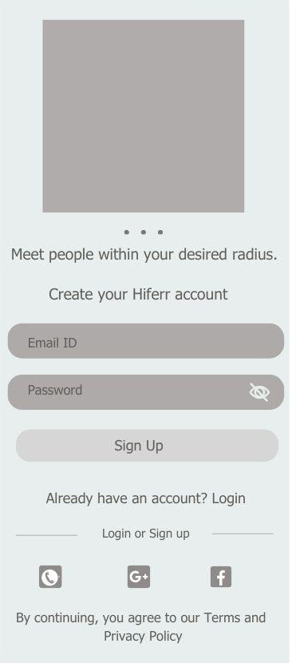

Onboarding screens Wireframes
Android
iOS

Slide 16
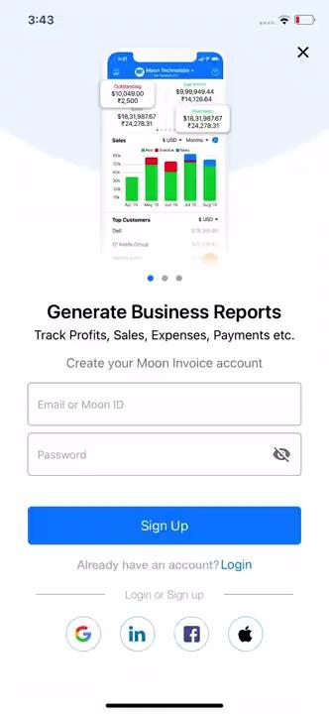
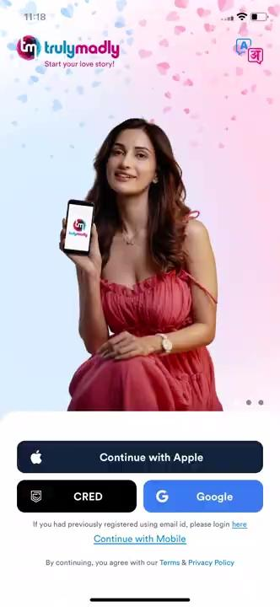
Onboarding screens references

Slide 17
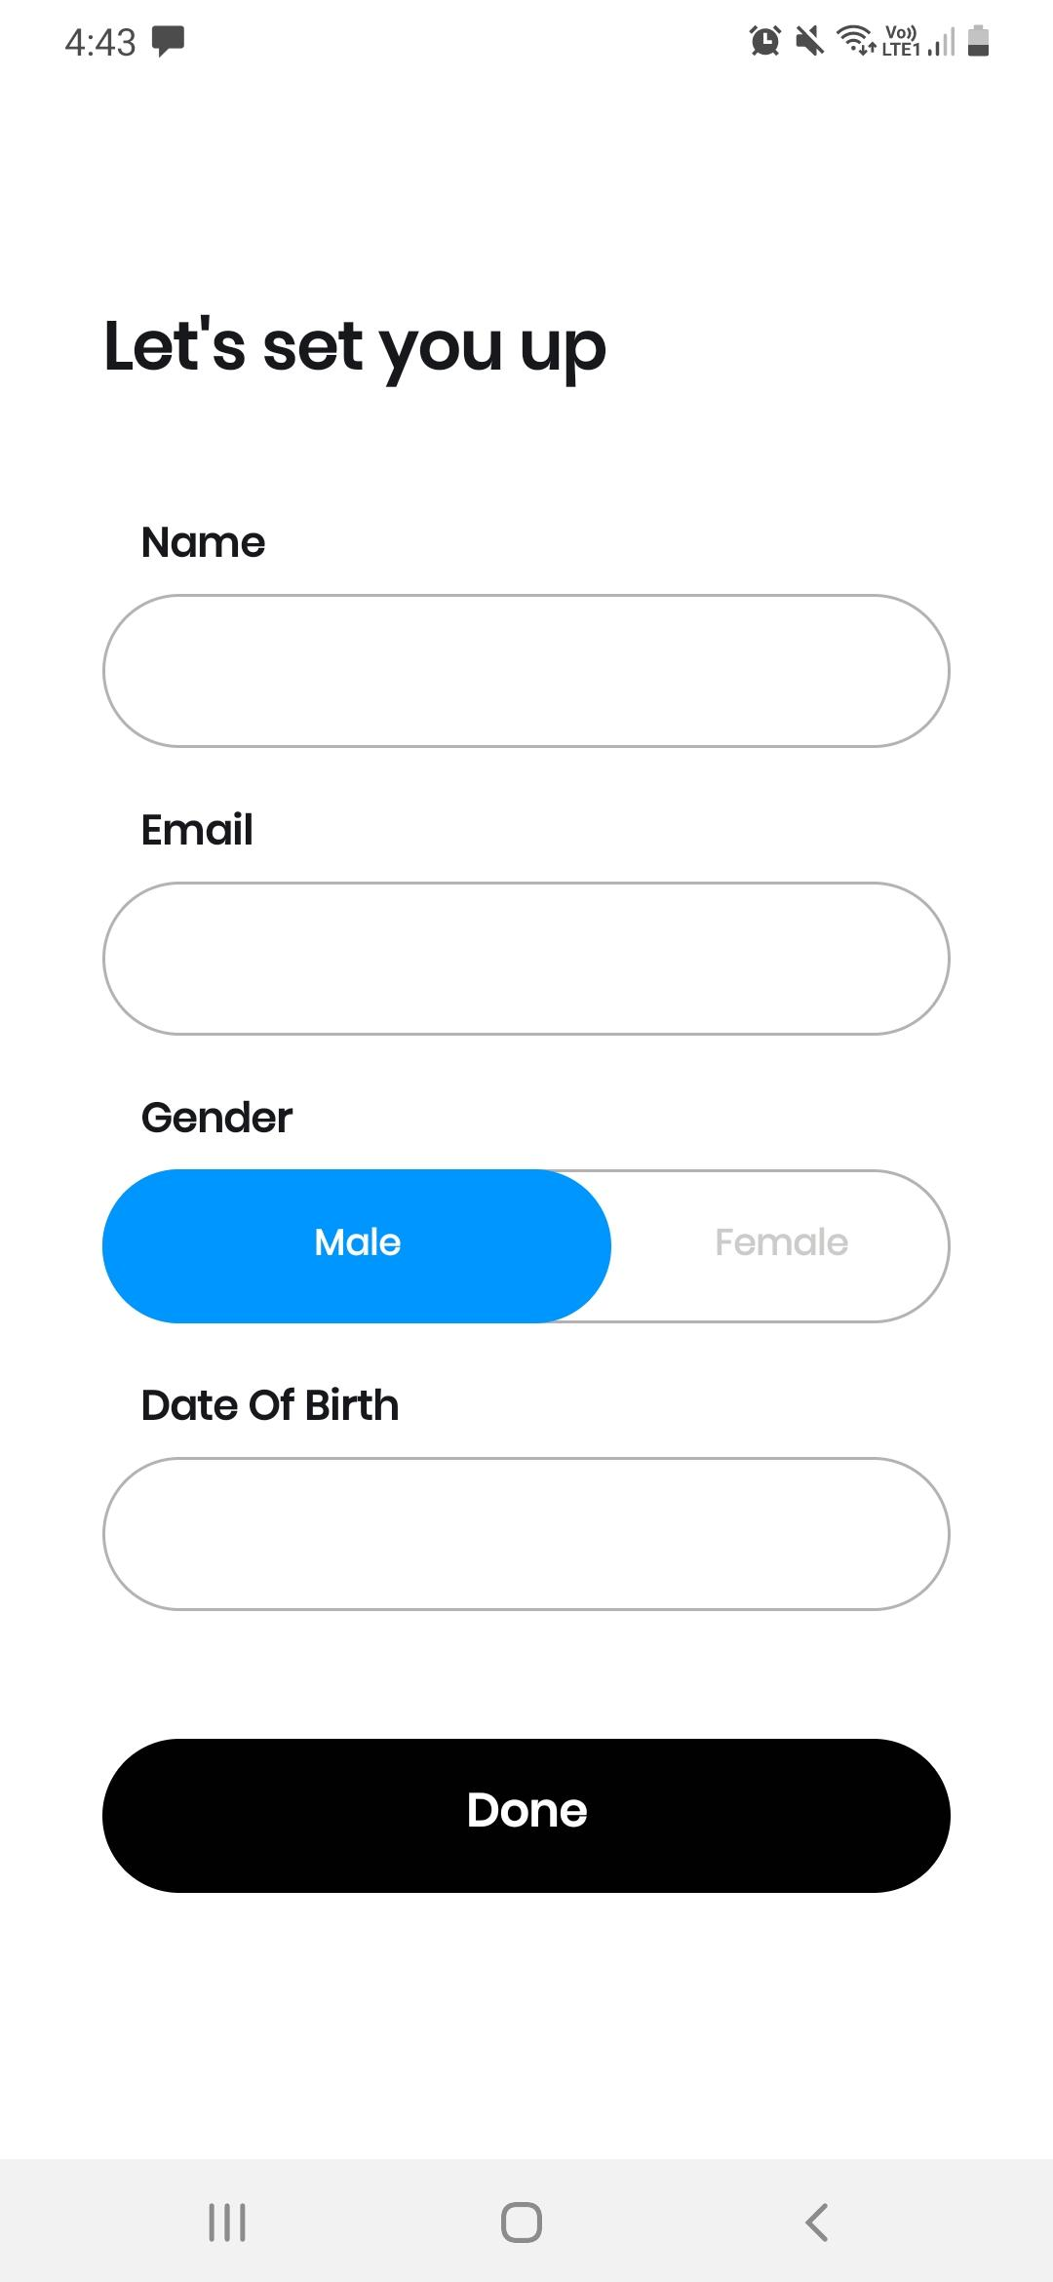
Personal Details Screen
We recommend offering users the opportunity to provide their email address at a later stage when filling out additional information, instead of including it in the personal information page.
The app must offer more gender identity options beyond the traditional male and female to be inclusive towards a wider range of gender identities. We could include “Other” as an option for gender as well.

Slide 18
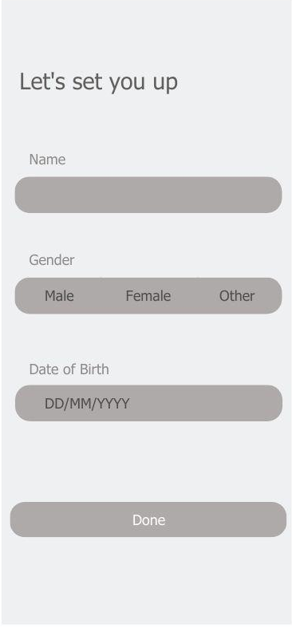
Personal Details Screen
The personal details can be automatically filled if the user creates an account through Facebook or Gmail - this will make the process quicker.
To streamline the process of filling out the Date of Birth, users could be given the choice to manually enter the date in the DD/MM/YYYY format, in addition to using the calendar option.

